Slide 1
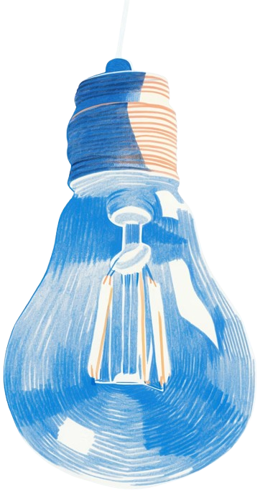


SAGE
Your Hiring Partner
Group Members
Ashar Naveed (22P-9346)
Muhammad Abdullah (22P-9321)
Dilawar Khan (22P-9099)
Project Supervisor
Mr. Shoaib Muhammad Khan

Slide 2

Introduction
The Need & Value of Auto-Match
Auto-Match adds value by:
Traditional hiring for academic staff is slow, biased, and time consuming.
Manual CV reviews and interviews often cause delays & inconsistency.
Candidates often get ghosted after applying (no feedback or updates).
  Reducing HR workload.
  Ensuring unbiased evaluation.
  Selecting the best matched candidates.
  Provides candidates with clear feedback and status updates.

Slide 3

Motivation
What if we do not build Auto-Match?
Faculty hiring will remain slow and inefficient, causing delays in filling key positions.
HR teams will stay overloaded, spending time on paperwork instead of quality evaluation.
Bias and favoritism risks remain high due to manual shortlisting.
Candidates will keep getting “ghosted” with no feedback or clarity about their application status.
FAST-NUCES may fall behind in digital transformation, while competitors adopt AI-driven
recruitment.

Slide 4


Problem Statement
Universities struggle with slow, biased, and unorganized hiring processes due to the absence of a smart, integrated system for evaluating, shortlisting, and matching candidates with suitable academic positions

Slide 5

Solution
Auto-Match – Smart Recruitment System
AI-based platform for end-to-end recruitment.
Key Features:
CV Parsing for extracting candidate details.
Automated Testing & Interview Scheduling.
Matching Algorithm for fair ranking based on skills, test and
interview performance.
User-Friendly Interface for HR and candidates.

Slide 6
Scope of the project
Candidate Management: Registration, resume upload & auto-data extraction
Assessment Engine: AI-generated, specific tests with cheating-prevention
AI Video Interviews: Identity verification, soft-skills evaluation, secure recordings
Smart Matching: Automated ranking & best-fit role suggestions
HR Dashboard: Candidate profiles, test/interview results, interview playback, shortlisting tools

Slide 7

Goals
Develop an AI-powered recruitment system for academia.
Ensure fair and unbiased evaluations.
Provide universities with easy-to-use dashboards.
Save time and effort in the recruitment process.
Improve quality of hiring decisions by recommending the best candidates

Slide 8
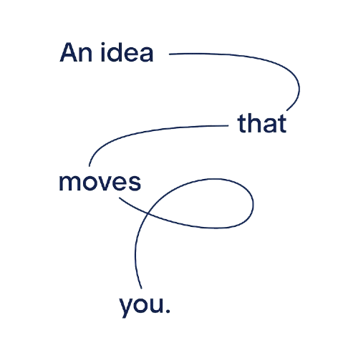
Expected Result
A functional Auto-Match prototype/system.
Candidates :
Human Resources :
Smart Hiring
Register & upload CVs.
Attempt AI-generated tests.
Give AI-monitored video interviews.
empowers
Access automated candidate rankings
Review test results & recorded interviews
Identify best-fit candidates by matching
Make faster & more reliable hiring decisions

Slide 9

Diagrams

Slide 10
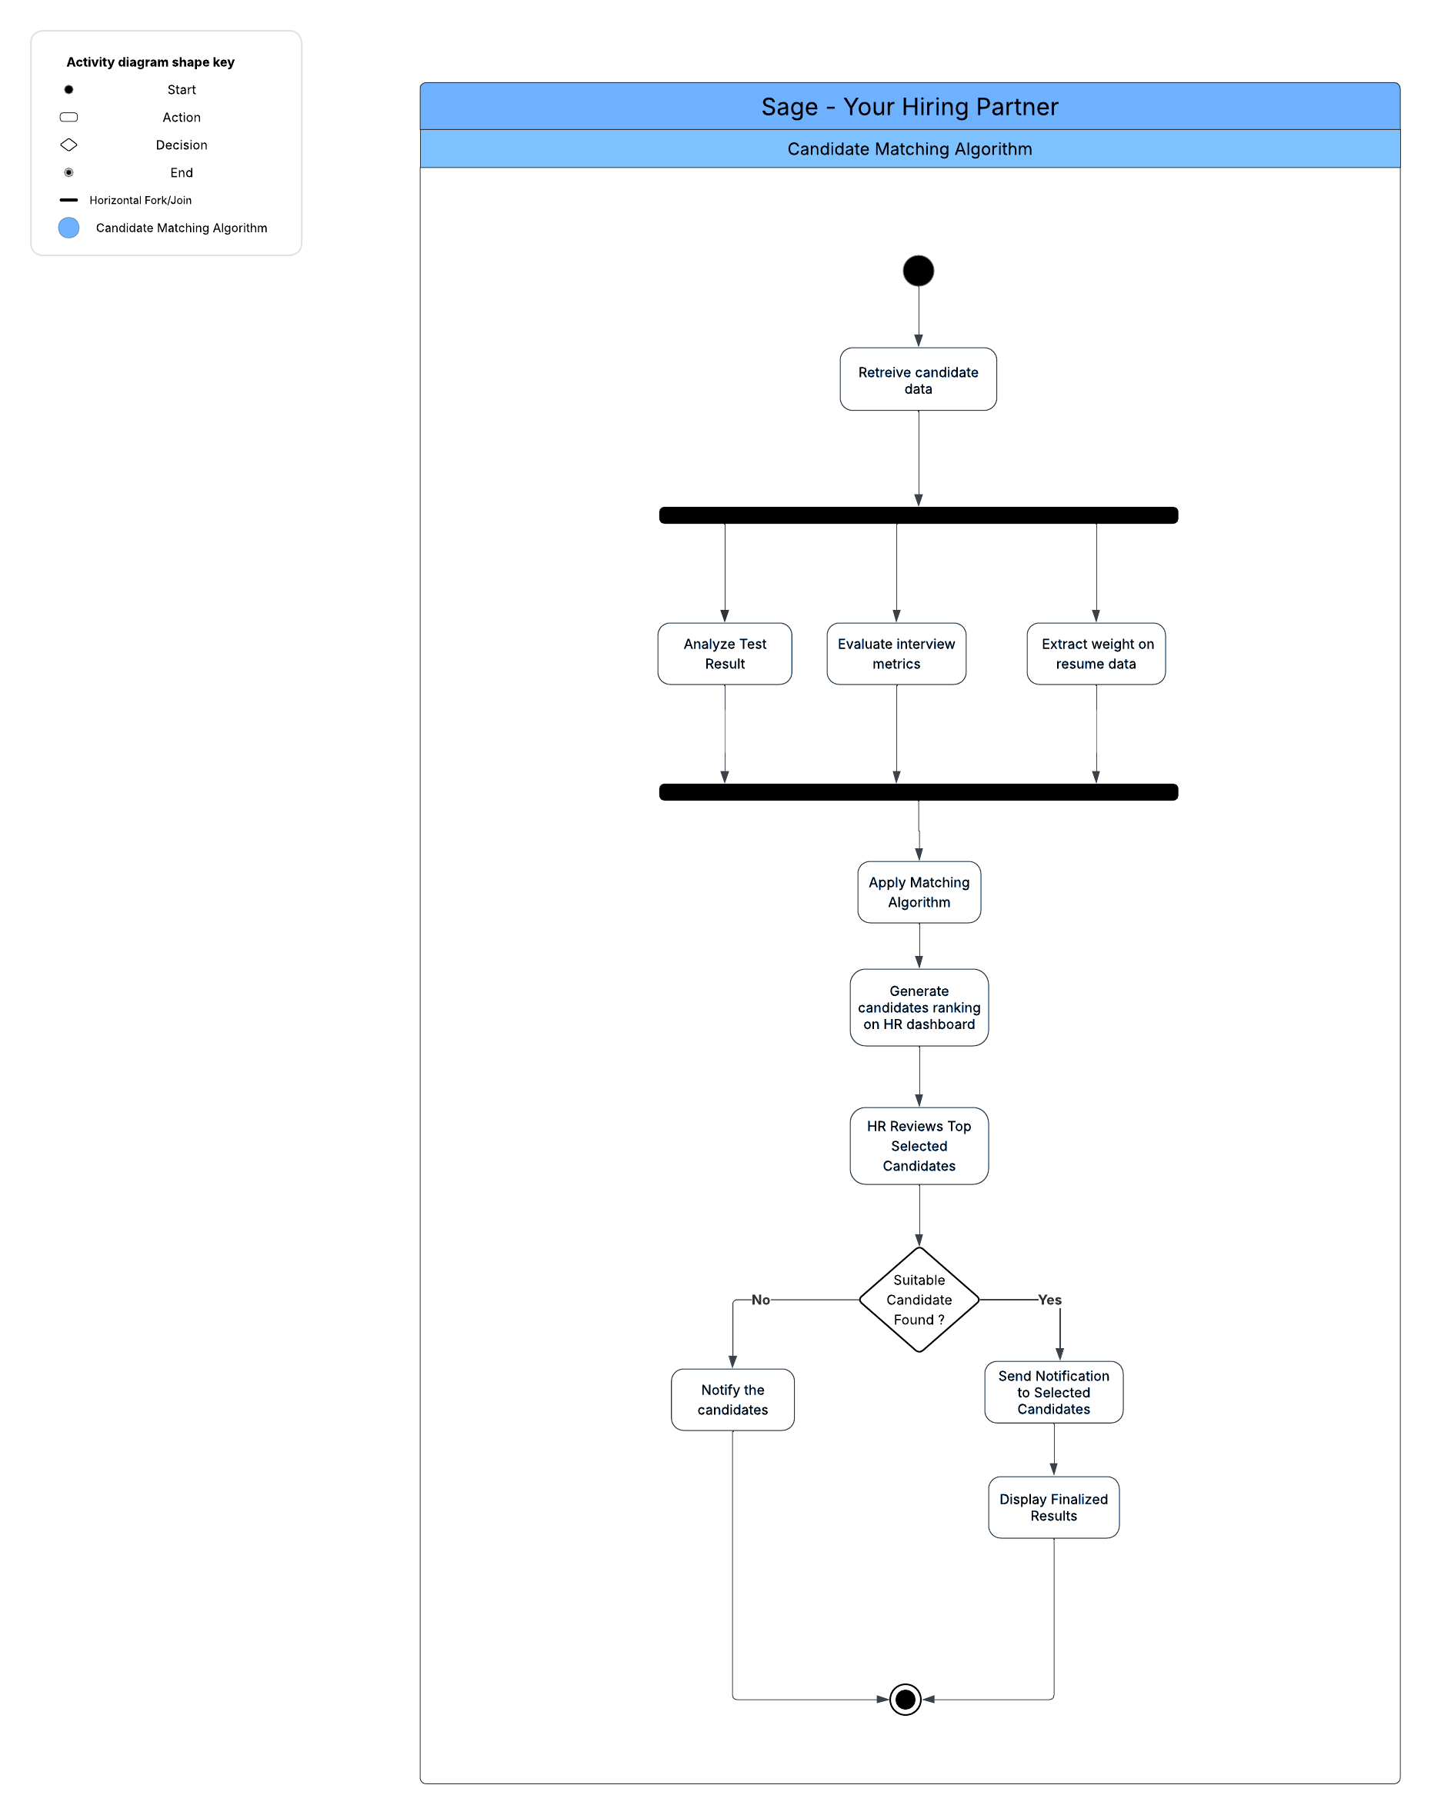

Slide 11
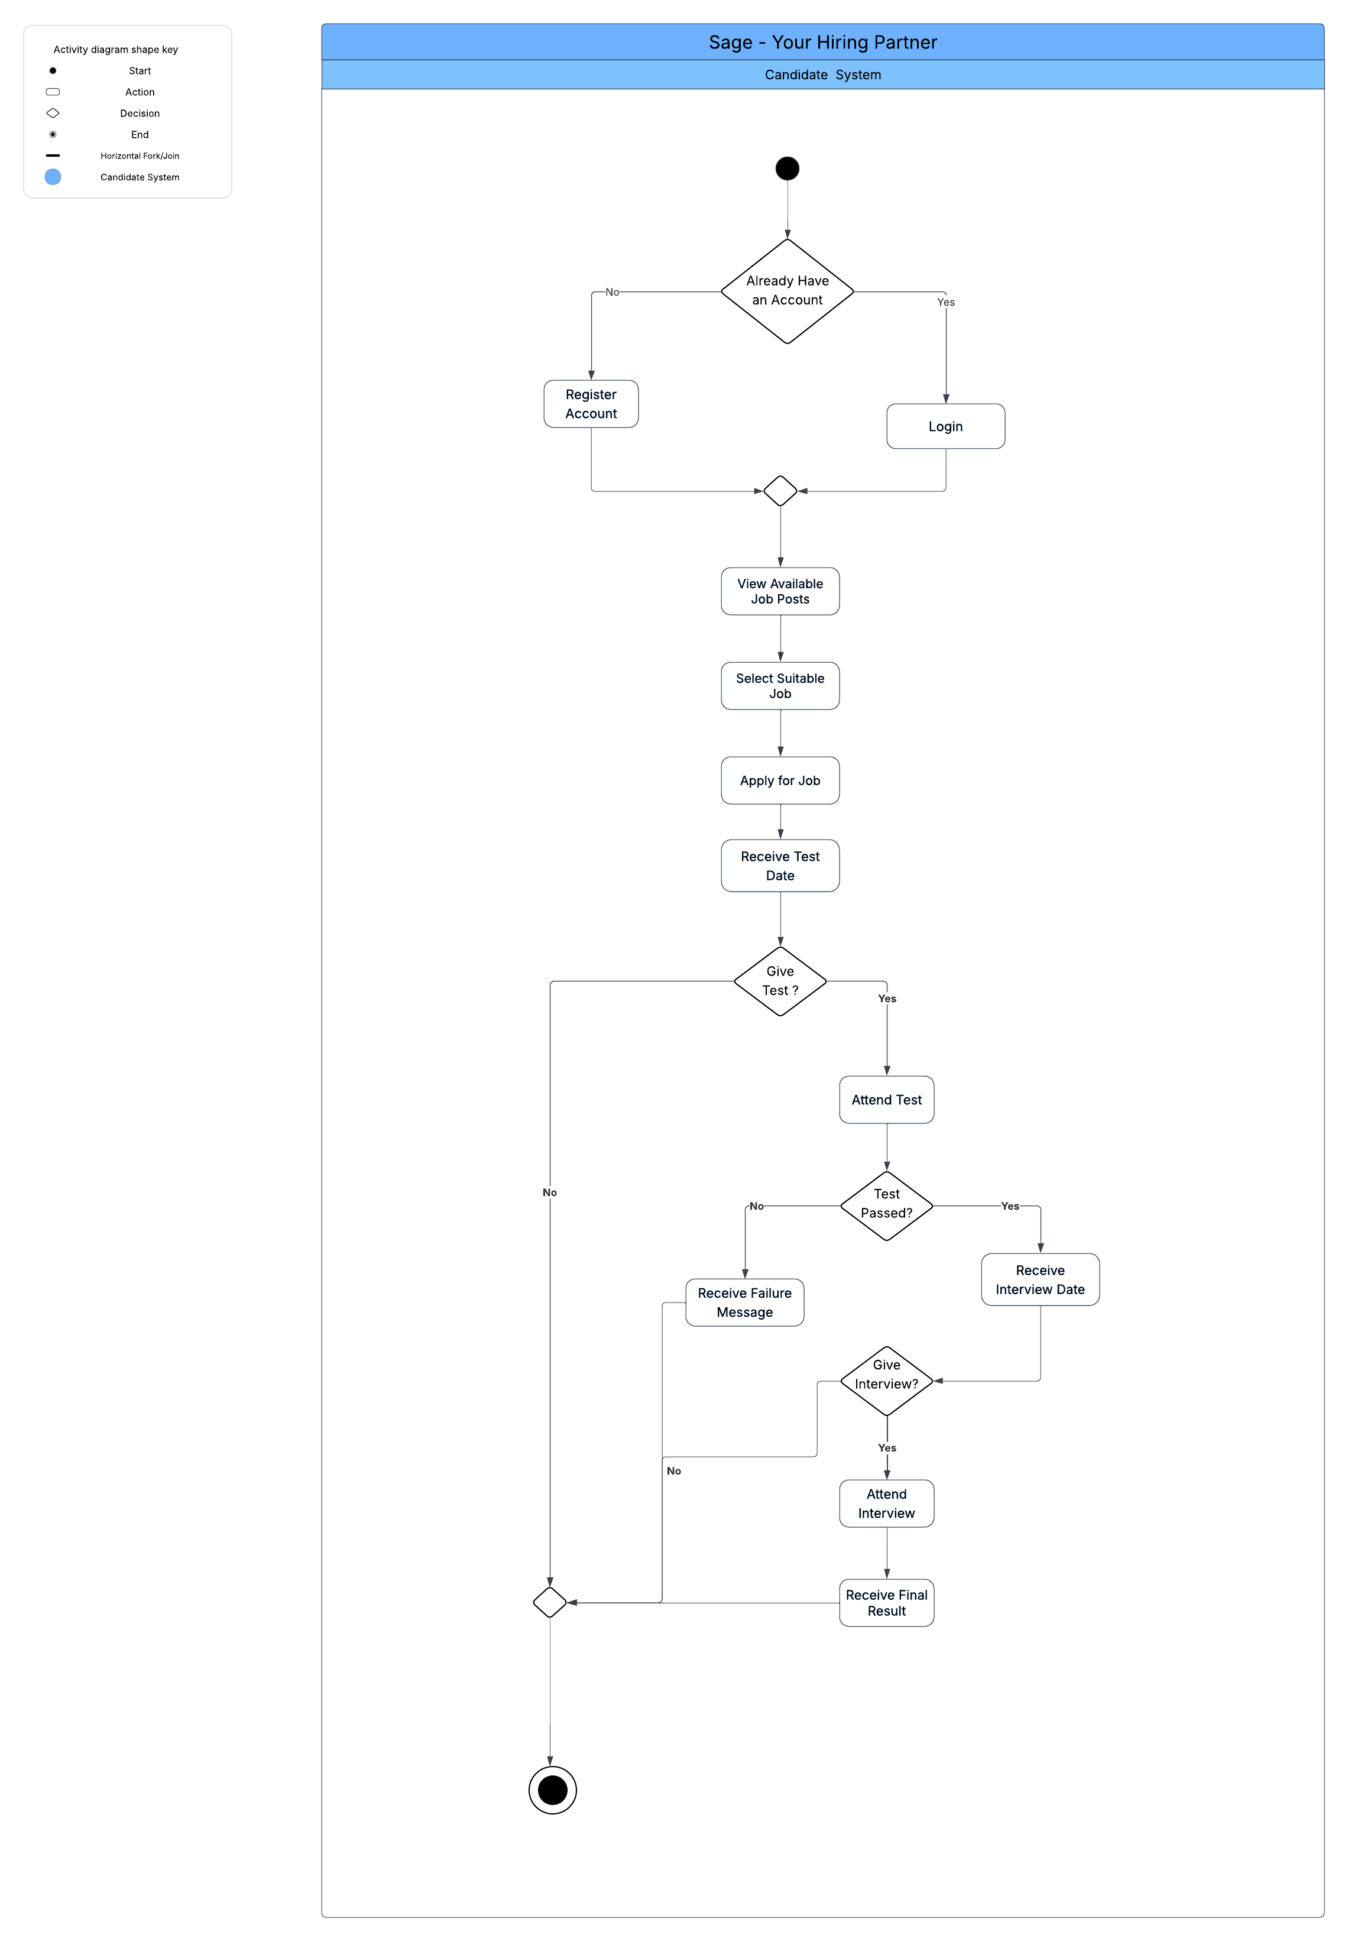

Slide 12
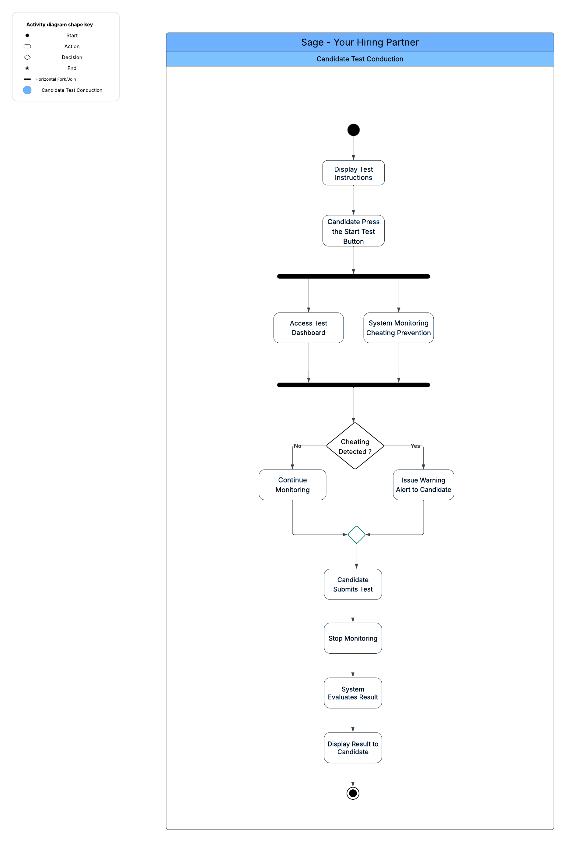

Slide 13
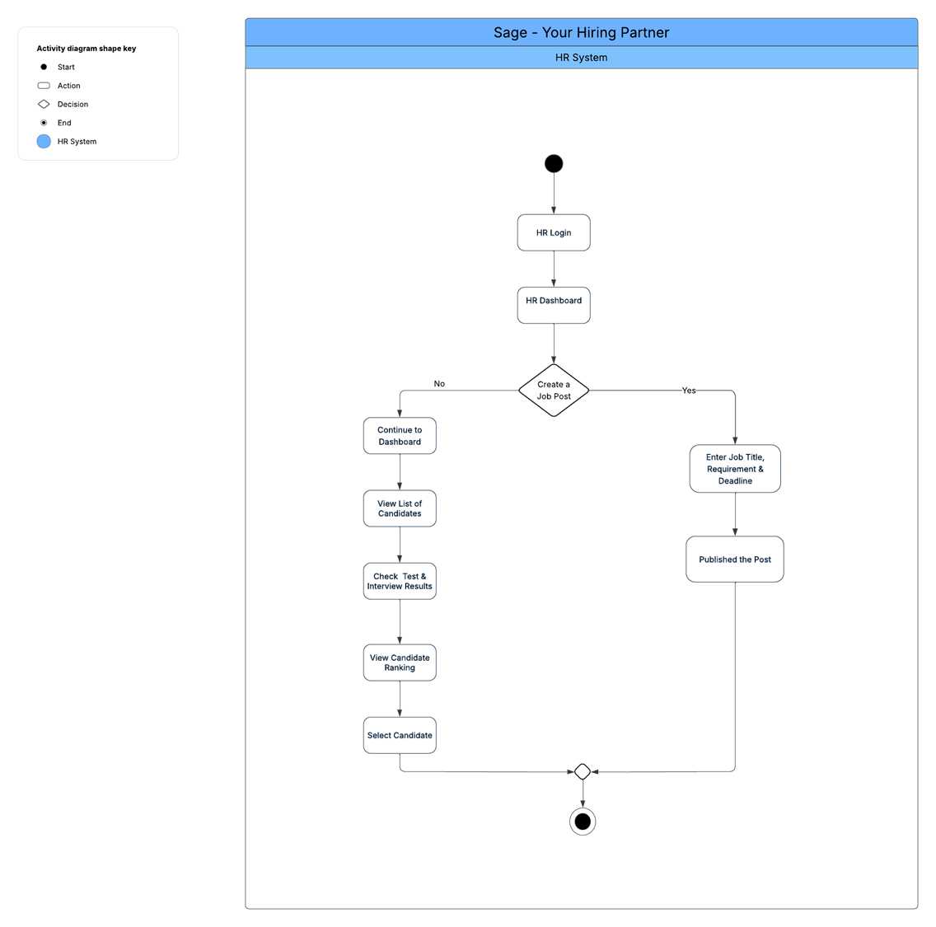

Slide 14
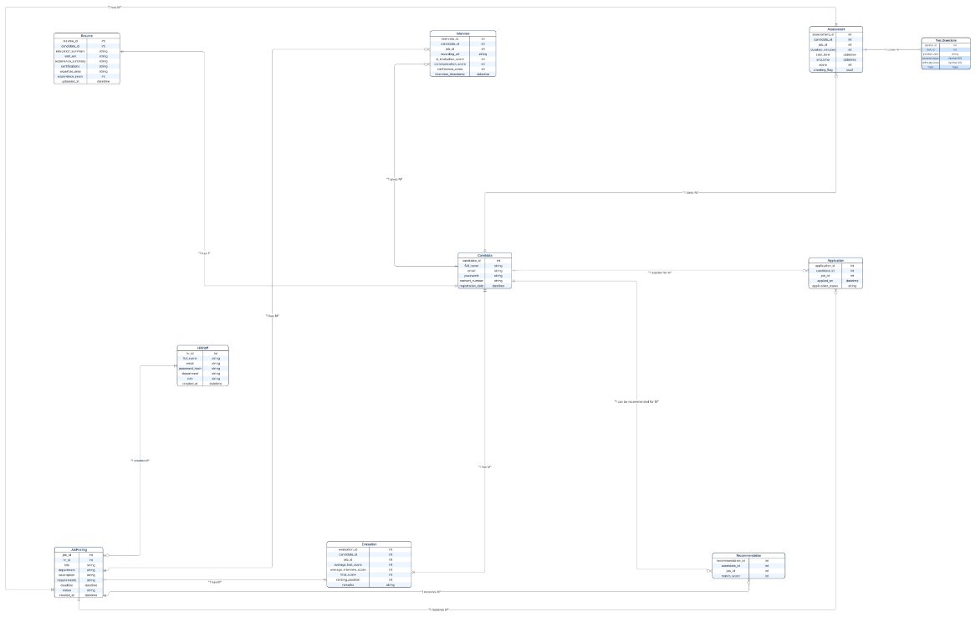

Slide 15
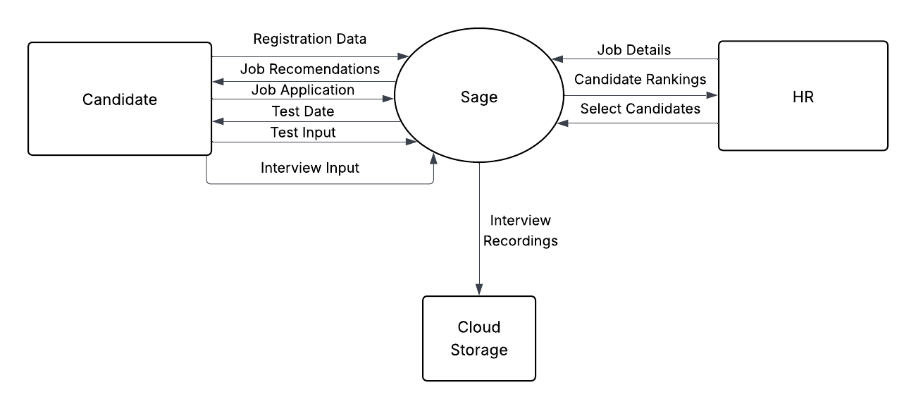

Slide 16
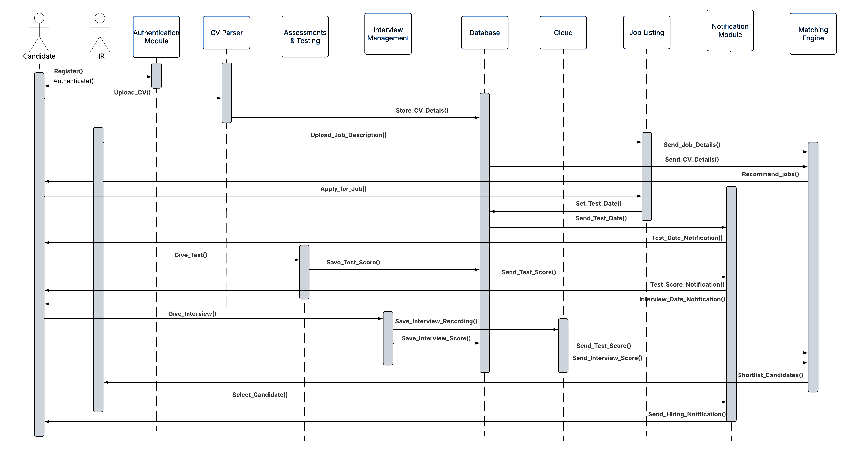

Slide 17
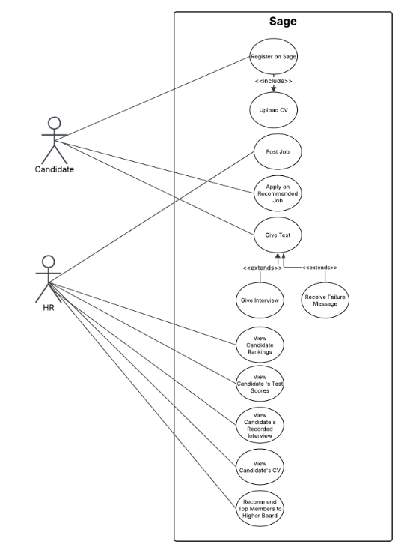

Slide 18
Timeline

Slide 19
Objectives
Task name | FYP Part | Month 1 | Month 2 | Month 3 | Month 4 | Month 5 | Month 6 | Month 7 | Month 8
Requirements gathering & stakeholder analysis | FYP 1
Define MVP, user personas & architecture | FYP 1
Wireframing (low-fidelity) | FYP 1
High-fidelity UI design | FYP 1
Database schema & backend design | FYP 1
Candidate portal (registration & CV upload) | FYP 1
HR dashboard (basic job panel) | FYP 1

Slide 20
Objectives
Task name | FYP Part | Month 1 | Month 2 | Month 3 | Month 4 | Month 5 | Month 6 | Month 7 | Month 8
CV parsing engine | FYP 1
AI knowledge-test module | FYP 1
Interview module (video + analysis, confidence, face-mapping) | FYP 2
Scoring & candidate matching | FYP 2
Email notification (selection / rejection)
Integration & usability testing | FYP 2
Final deployment | FYP 2
Documentation | FYP 1/2

Slide 21

Team Work
Project Phase | Task / Activity | Lead | Support
Requirements Gathering | Collect requirements, define MVP & user personas, prepare diagrams (Use-case, Flow) | Dilawar | Ashar, Abdullah
Wireframing & Design | Wireframing (Low-Fidelity), High-Fidelity UI Design, Component Breakdown Discussion |  | All Members
Frontend Development (Phase 1) | Build UI Components ( e.g. Candidate portal, HR dashboard ) | Ashar | Dilawar, Abdullah
Backend Development | Backend implementation & APIs | Ashar | Ashar, Dilawar
Database | Schema design & queries | Dilawar | Ashar, Abdullah
CV Parsing Module | Resume upload, extract key details | Abdullah | Dilawar, Abdullah
Test Conducting Module | AI test engine, randomized questions, cheating prevention | Dilawar | Ashar, Abdullah
Frontend Development (Phase 2) | Continue frontend, CRUD, UI review & styling |  | All Members
Interview Module | AI video interviews, ID verification, soft skills analysis | Abdullah | Ashar, Dilawar
Integration & Matching | integration, ranking algorithm, optimization | Ashar | Abdullah, Dilawar
Unit Testing | Test individual components |  | All Members
Deployment & Hosting | hosting | Abdullah | Ashar, Dilawar
Documentation | final documentation |  | All Members

Slide 22
Goal Achieved
Main Task / Goals | Detailed Work Completed | Status
Candidate Portal (Registration & CV Upload) | Implemented user registration, login, and CV upload functionality. Form validation and basic UI completed. | Partially Completed
HR Dashboard (Basic Job Panel) | Designed dashboard layout, added job listing panel, and basic CRUD operations for job posts. | Partially Completed
CV Parsing Engine | Developed parser to extract key candidate information (name, contact, education, skills) from uploaded CVs. | Completed
AI Knowledge-Test Module | Built AI-powered test module, including question bank and automatic scoring. | Completed

Slide 23
User Interface

Slide 24
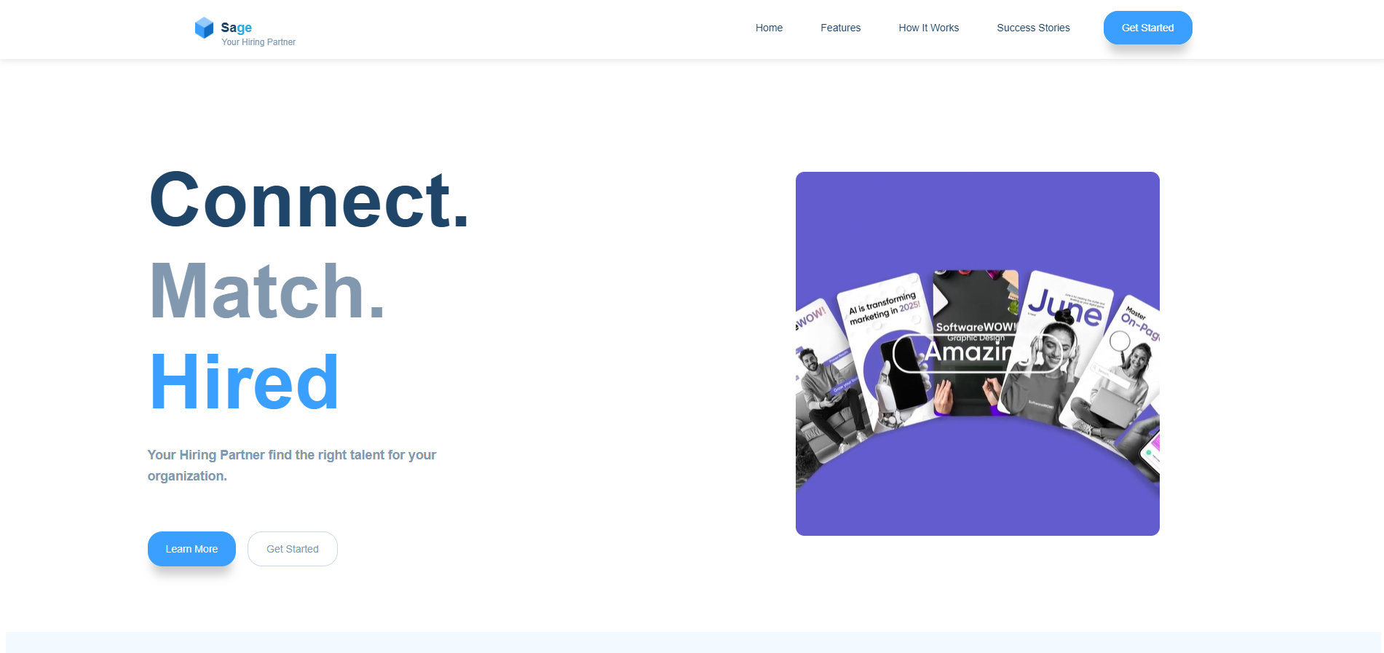

Slide 25
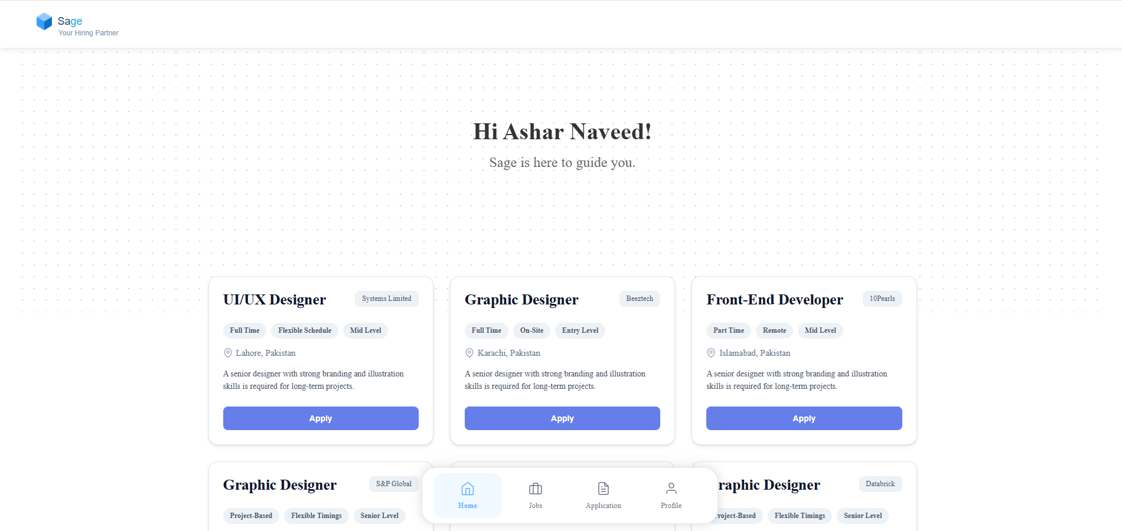

Slide 26
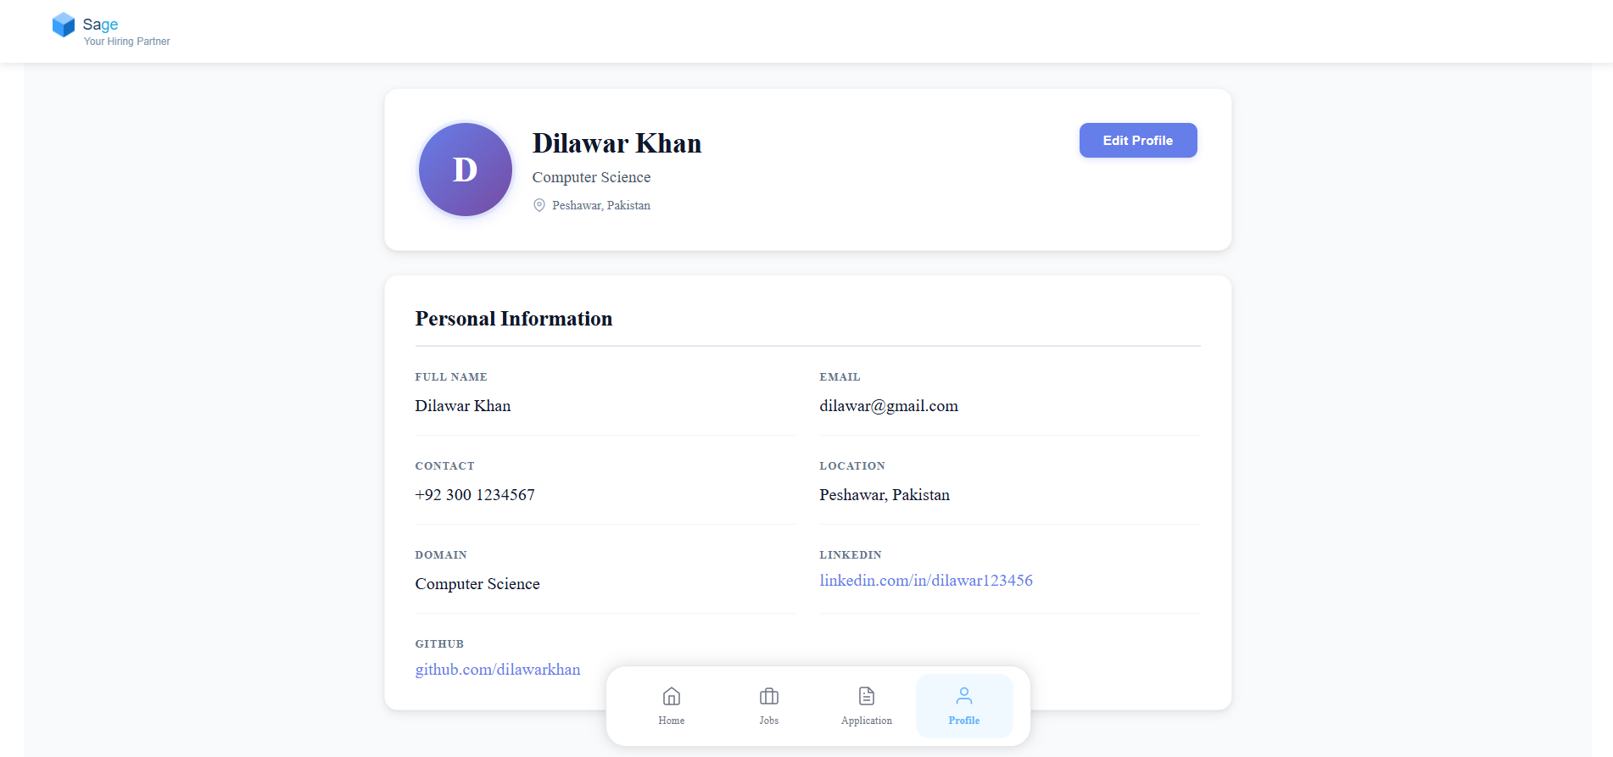

Slide 27
References
[1] Elviwani, Siahaan, A. P. U., & Fitriana, L. (n.d.). Performance-based Stable Matching using Gale–Shapley Algorithm.
[2] Suakanto, S., Siswanto, J., Prasetyo, I. R., Hardiyanti, M. (2021). Interview Bot for Improving Human Resource Management. In 2021 Int. Conf. on ICT for Smart
Society (ICISS), pp. 4644–4647. IEEE. DOI: 10.1109/ICISS53185.2021.9533248.
[3] Mendoza, A. A. D., Barbosa, L. J. C., Cortez, D. M. A., Dioses, R. M., Agustin, V. A., Regala, R. C. (2022). Enhancement of Gale–Shapley algorithm witimbalanced
sets for hiring and job finding applications. Indonesian Journal of Electrical Engineering and Computer Science, 27(2), 954–958. DOI: 10.11591/ijeecs.v27.i2.pp954
958.
[4] Will, P., Krpan, D., & Lordan, G. (2023). People versus Machines: Introducing the HIRE Framework. Artificial Intelligence Review, 56, 1071–1100. Accepted: 13 April 2022. DOI: 10.1007/s10462-022-10193-6.

Slide 28
[5] Thangaramya, K., Roselind, J. D., Logeswari, G., Ahirwar, N., & Gajendran, S. (2024). Automated Resume Parsing and Ranking using Natural Language Processing. In 2024 3rd IEEE Int. Conf. on Artificial Intelligence for Internet of Things (AIIoT). DOI: 10.1109/AIIoT58432.2024.10574696.
[6] Hosseini, H., Roy, S., & Zhang, D. (2024). Putting Gale & Shapley to Work: Guaranteeing Stability Through Learning. In 38th Conf. on Neural Information Processing Systems (NeurIPS 2024).
[7] Aly, A. M., El Alem, A., Alawida, M., AlBloushi, S., & Aldhaen, G. (2025). Optimizing Recruitment with AI: A Smarter Approach to Candidate Evaluation. In
20
Sage — Literature Review 2025 1st Int. Conf. on Computational Intelligence Approaches and Applications (ICCIAA). DOI: 10.1109/ICCIAA65327.2025.11013684.
[8] Mujtaba, D. F., & Mahapatra, N. R. (2025). Fairness in AI-Driven Recruitment: Challenges, Metrics, Methods, and Future Directions. arXiv preprint arXiv:2405.19699v3.

